Slide 2
“The purpose of this event is to fundraise for Seneca Habitat for Humanity, while increasing awareness of the organization and promoting community”

Slide 3
Event Description
Location
Duration 11:00 AM-5:00 PM
Goals: 300 people & 5,000 dollars

Slide 4
Audience
Seneca County Community
Schools/Teams
Groups/Churches
Habitat for Humanity Volunteers
Families . . . .

Slide 5
“Before We Begin”
Saturday, June 15
“2013 Annual Bloomville UCC Strawberry Festival
DATE CHANGE

Slide 6
Price & Ticket
Presale/Registration
10 or More Group Discount
Day-of Registration

Slide 7
Promotions
Commercial/Video Clip
10 or More Group Discount
“Piece it Together”
Live Entertainment
iHelp Children’s Writing Competition
Notes:
Also talk about advertising around town/social media and press release

Slide 8
Budget & Break Even
Sponsorships & Donations of $2,375 needed to reach goal of $5,000
Donation of Food

Slide 9
Risks
1 Weather
2 Traffic Management/Crowd Control
3 Finances
4 Staff Management
5 Health & Safety
6 Loss of Electricity

Slide 10
Staffing

Slide 11
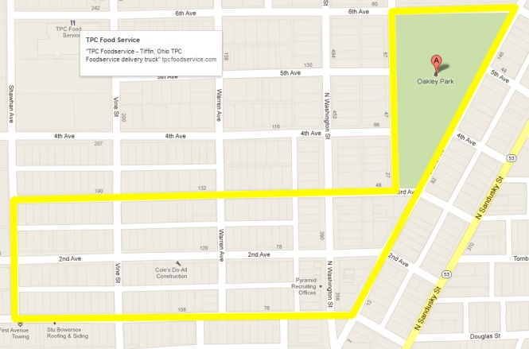
5K Run/Walk Map

Slide 12
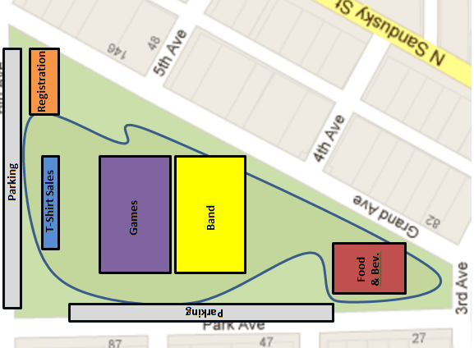
Event Activities Map

Slide 13
Thank You “)

